Slide 1
The Metropolitan Museum of Art http://www.metmuseum.org/

Slide 2
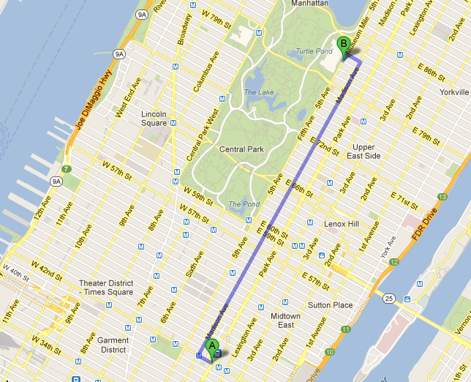

Slide 3
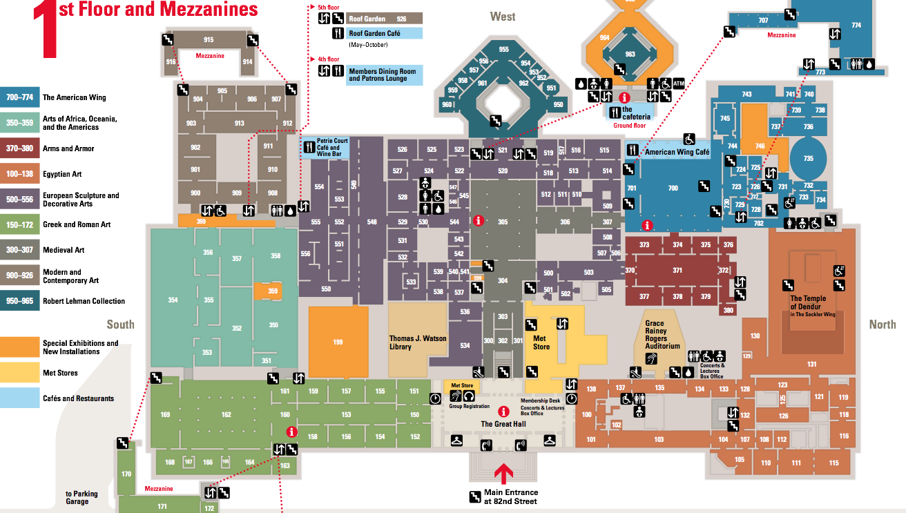

Slide 4
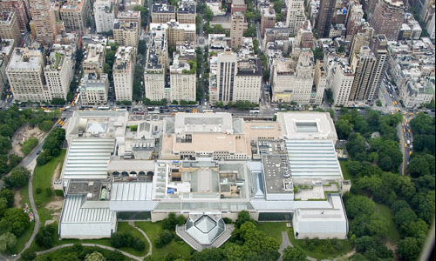

Slide 5
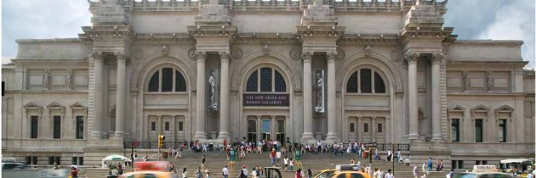

Slide 6
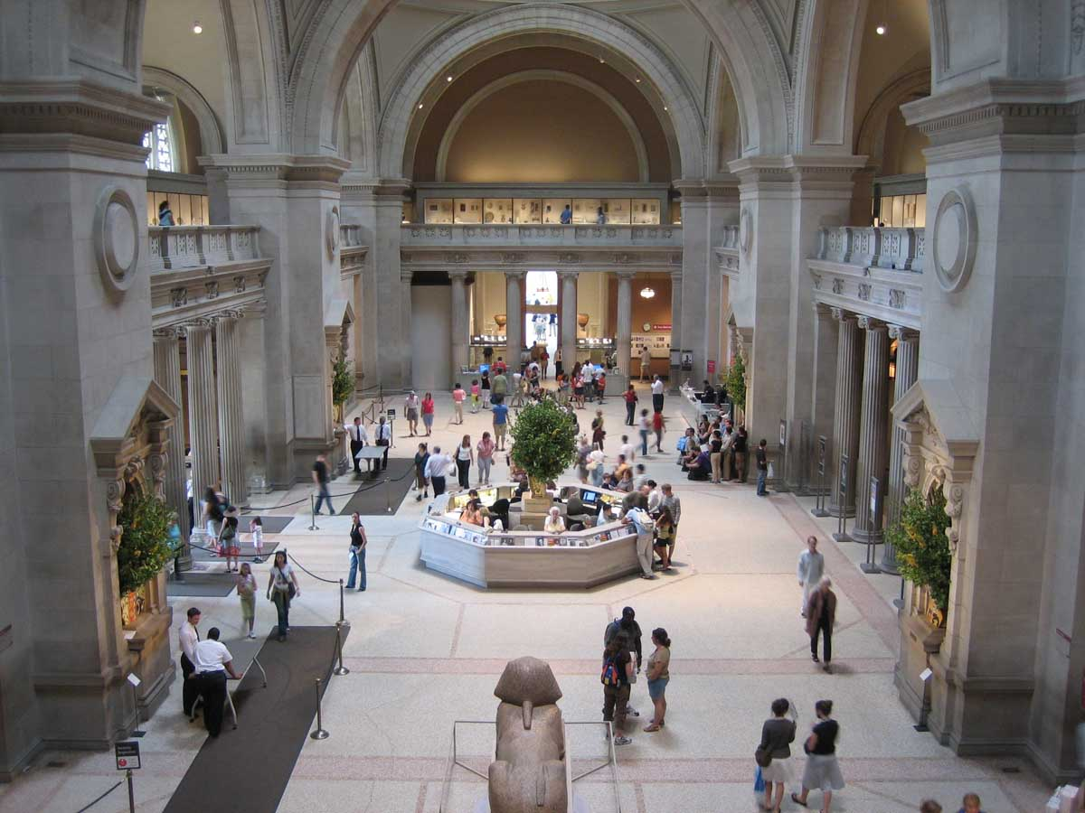

Slide 7
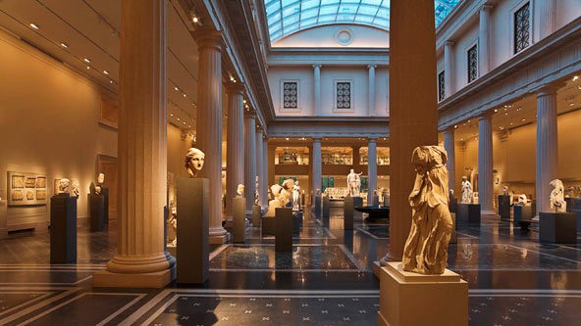

Slide 8
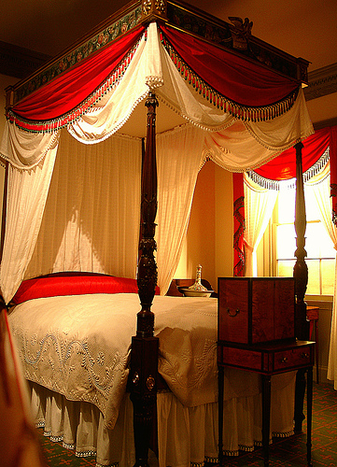

Slide 9
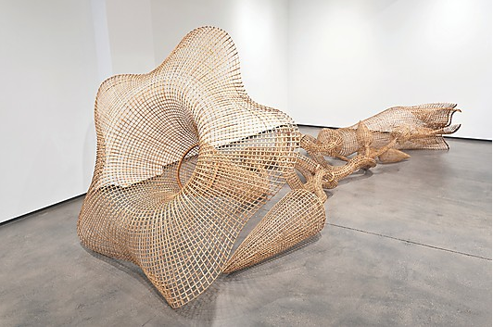
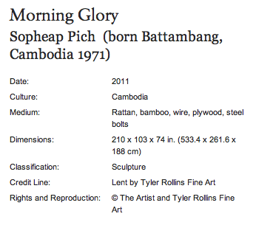

Slide 10
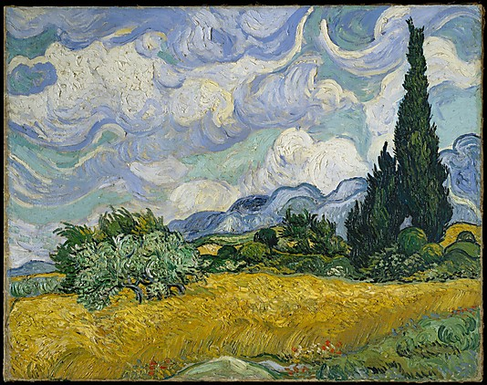
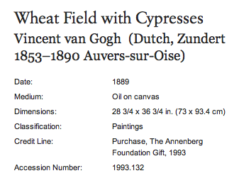

Slide 11
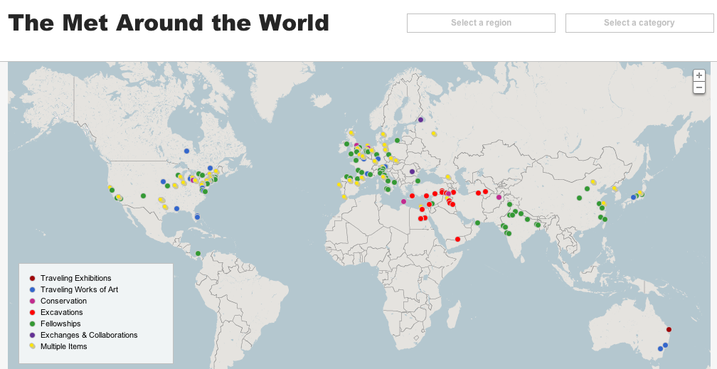

Slide 12
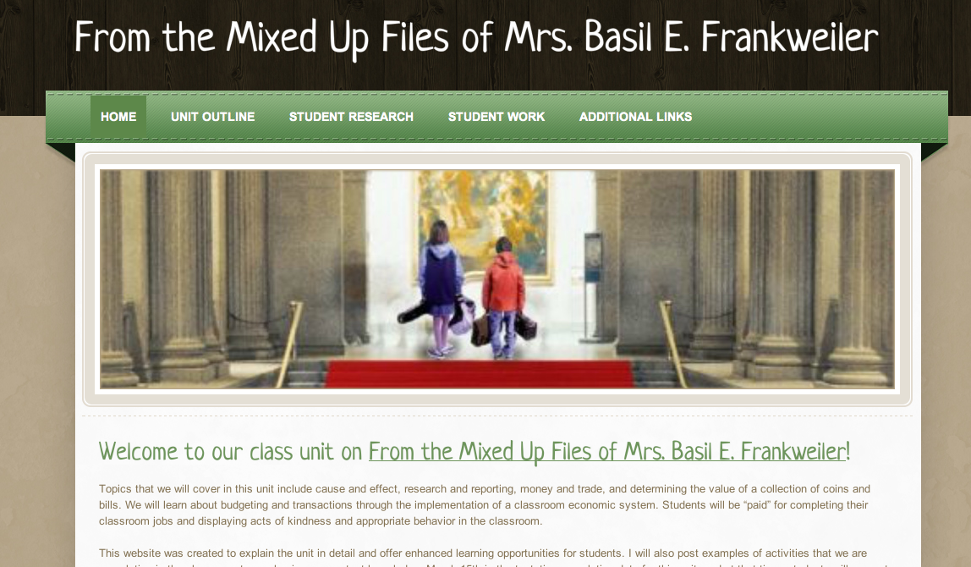
http://mitchellthirdgrade.weebly.com/

Slide 13
Class Final Project
We are going to create exhibits in a museum. You may use an exhibit you heard about or know about already. You may also create an exhibit based upon something that you are interested in. Your exhibit could be over a specific time period or collection of items. You will be working in your table groups to complete this final project. I will give you more details about this project soon, but start brainstorming ideas with your group right now! :)

