Slide 1
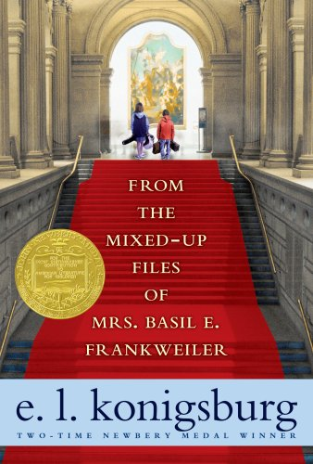
From the Mixed-Up Files of Mrs. Basil E. Frankweiler
By: E.L. Konigsburg
Copyright: 1967

Slide 2
About the Novel
Won the annual Newbery Medal for excellence in American children’s literature in 1968
Chosen as one of the “100 Best Books for Children” in 2005 by National Education Association
Named one of the "Top 100 Chapter Books" of all time in 2012 by the School Library Journal

Slide 3
Whose perspective?
This story is told from the perspective of Mrs. Basil E. Frankweiler as she write a script to her lawyer, Saxonberg.
Sometimes she speaks directly to him using parentheses.
As we are reading, how can we distinguish (show the difference between) her talking and the story she is telling?

Slide 4
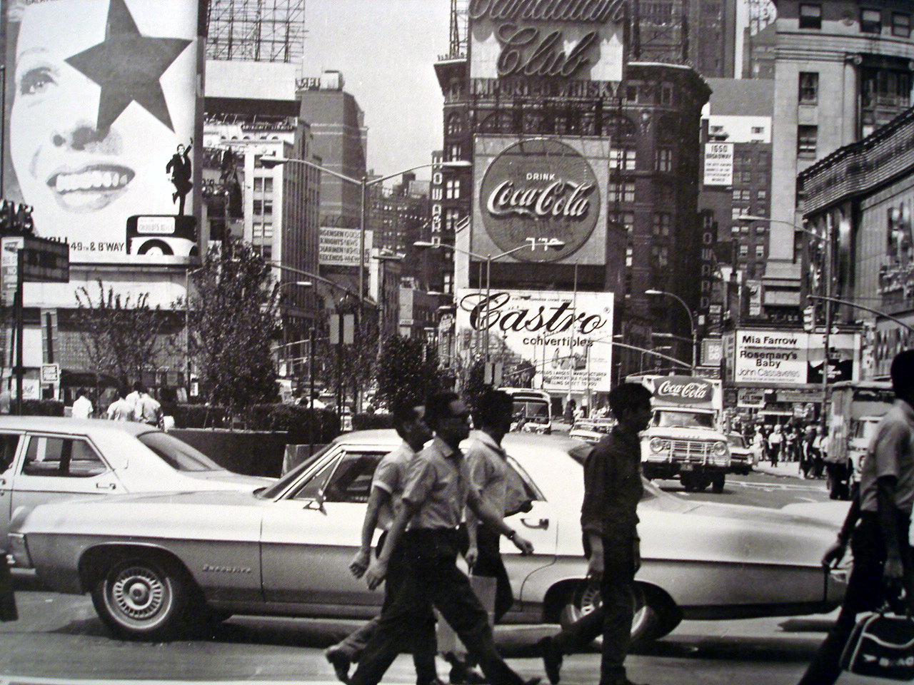
What were the 1960s like in New York City?

Slide 5
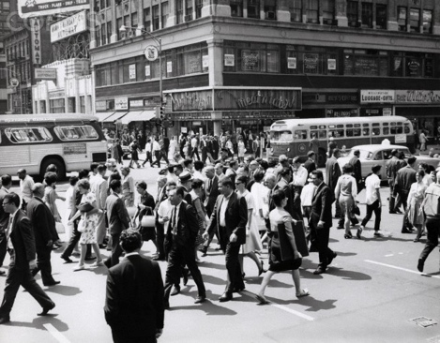
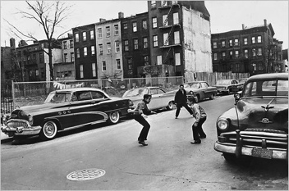

Slide 6
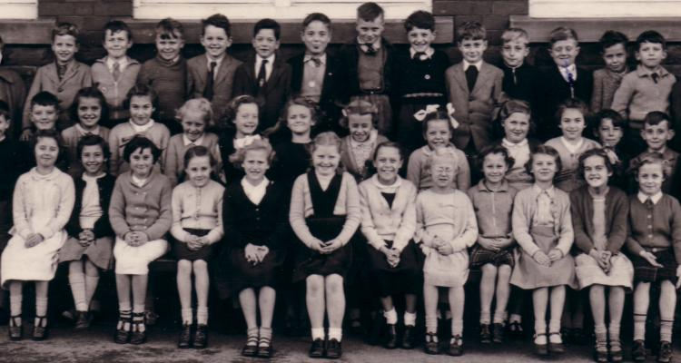
What did they wear in the 1960s?

Slide 7
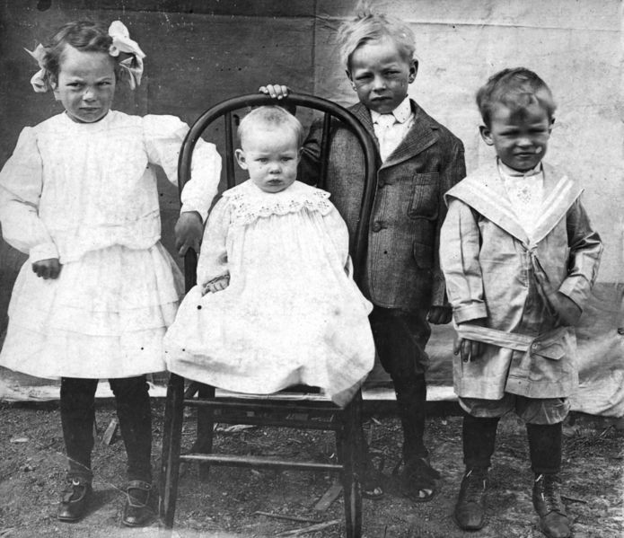
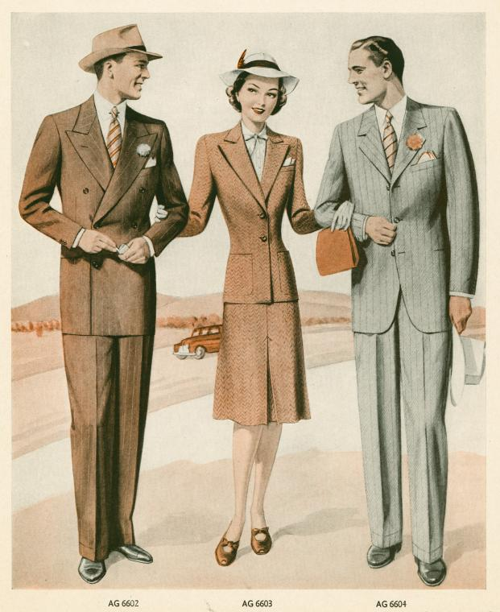

Slide 8
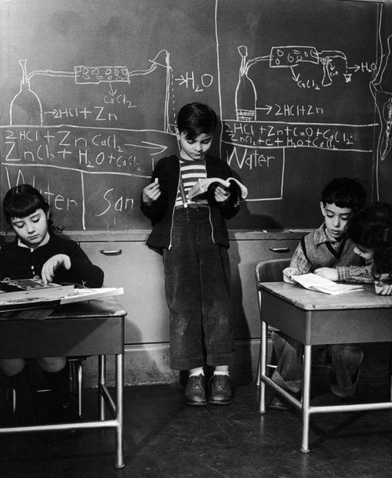
What would school look like in the 1960s?

Slide 9
